Slide 1



A Presentation on
Notification Portal
By:
Ekta Yadav (22ERASE600)
Shailendra Ahir (22ERASE601)

Slide 2
Agenda
Introduction
Existing system
New system – notification portal
Demo
Future enhancements
Questions and answers

Slide 3
Introduction
Notice board is good, WhatsApp is better, A dedicated communication channel is great.

Slide 4
Existing system
Direct call to students
WhatsApp groups and communities
Notice board
Face to face communication

Slide 5
New System –
Notification portal
Aims to supplement the existing system
Bulk SMS and Email to students
Any combination of groups can be created
Can be extended to fulfill many communication requirements – like supports team group, fee pending group, hostel students group, alumni group, B. Tech group

Slide 6
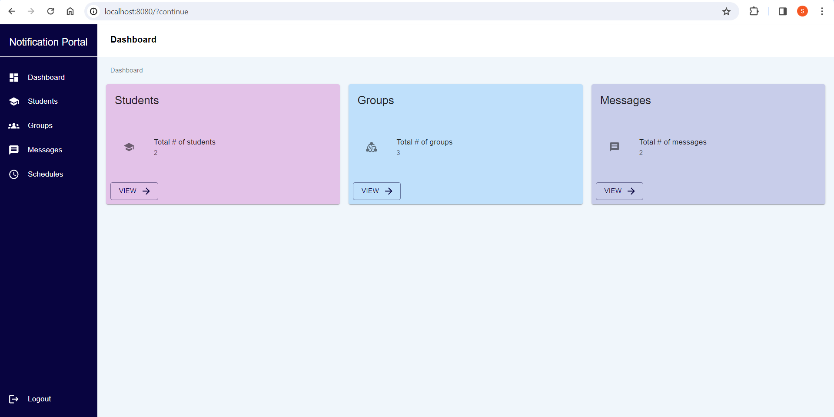
Demo

Slide 7
Future Enhancements
WhatsApp integration
ChatBots
Social media connects – X.com tweets, Facebook page posts, LinkedIn notifications
A dedicated extension on student's laptop
A dedicated communication for student's smartphone

Slide 8


Slide 9
Links
GitHub Repository - https://github.com/shailahir/student-connect-app
Email ID – Shailendra Ahirshailendra@shailahir.com
Email ID – Ekta Yadav ektayadav818@gmail.com

Slide 10


